Slide 1
Functional Testing
Functional Testing is a type of software testing that validates the software system against the functional requirements/specifications.
Functional testing is executed in the early stages of development.
Functional testing provides the guidance, validation, and inspiration that QA teams need in order to deliver great software products.

Slide 2
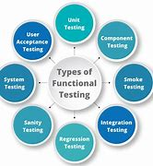
Types of Functional Testing
Unit Testing
Component Testing
Smoke Testing
Sanity Testing
Integration Testing
System Testing
User acceptance Testing
Regression Testing

Slide 3
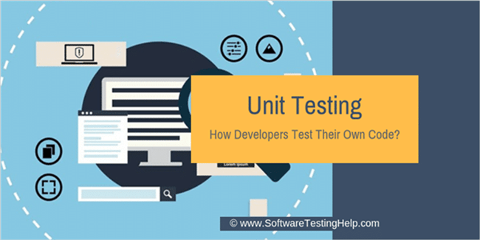
1) Unit Testing
Testing the smallest testable unit of an application.
A smaller code unit can be a function, method, or class.
It test each module individually.
Unit testing occurs during the SDLC’s initial phase by the team of developers.
It is the way to test whether it is developed correctly.

Slide 4
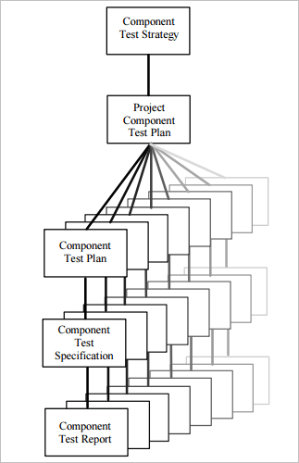
2) Component Testing
Component Testing is performed after unit testing.
It is focused on many smaller units.
It is the combination of few multiple units.
Component testing is done by developers when the software
is ready for release to the testing team.
It is a black box testing technique that evaluates the
application without considering the code information.

Slide 5
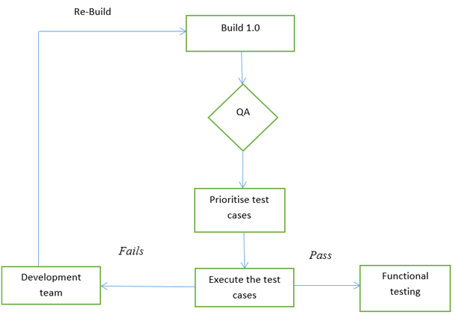
3) Smoke Testing
Known as build verification testing or confidence testing
Smoke Testing is a software testing process that determines whether the deployed software build is stable or not.
Smoke tests means verifying the important features are working as it's the entry level testing.
Smoke Testing is performed by QA engineers/QA lead.
Smoke testing can be done either manually or by automation depending on the client and the organization

Slide 6
Advantages of Smoke testing
Easy to perform testing
Defects will be identified in early stages.
Improves the quality of the system
Reduces the risk
Progress is easier to access.
Saves test effort and time
Easy to detect critical errors and correction of errors.
It runs quickly.

Slide 7
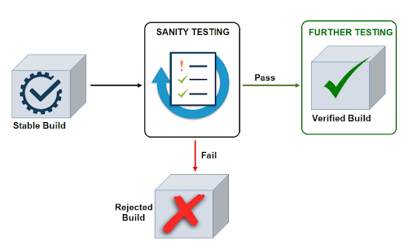
4) Sanity Testing
Sanity Testing is done to check the new functionality.
Code changes introduced are working as expected.
Sanity Testing is a subset of regression testing.
Performed by testers.
While checking Sanity testing we should check Smoke testing also.

Slide 8
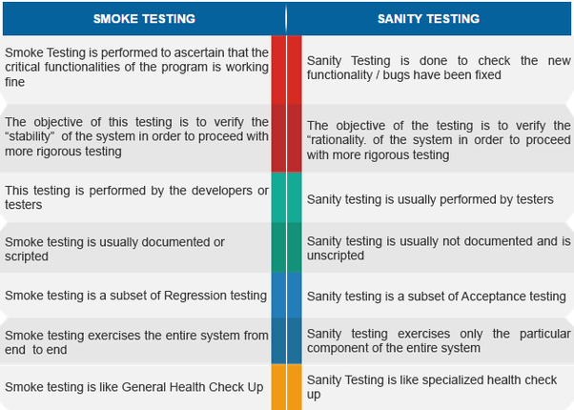

Slide 9
5) Integration Testing
It is performed to verify the interactions between modules are first tested individually and then combined to make a system.
Integration testing ensures that every integrated module functions correctly
Testers can initiate integration testing once a module is completed and doesn’t require waiting for another module to be done and ready for testing

Slide 10
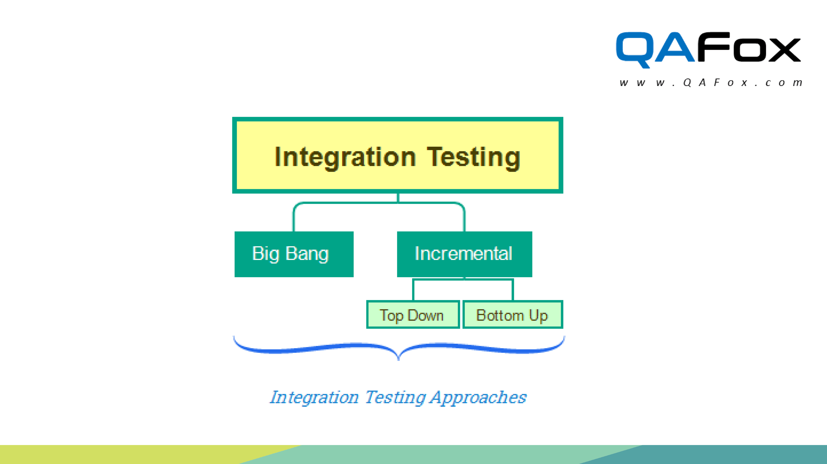
Types of Integration Testing
Big Bang Method : Also known as non-incremental
integration testing. This method involves integrating all the modules and components and testing them at once as a single unit.
Incremental Approach : This approach integrates
two or more logically related modules, then tests
them. The tester can use either the top-down
or bottom-up methods.
Hybrid Testing Method / Sandwich Approach :
It involves simultaneously testing top-level modules
with lower-level modules and integrating lower-level modules with top-level modules, and testing them as a system.

Slide 11
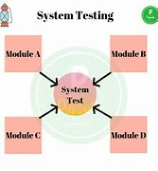
6) System Testing
Validates complete and fully integrated software product.
Check whether the software or product meets specified requirements or not.
System Testing is defined as a series of different tests whose sole purpose is to exercise the full computer-based system.
More than 50 types of system testing. Some are :
Usability
load testing
Regression Testing
Migration
Functional
Hardware/software

Slide 12
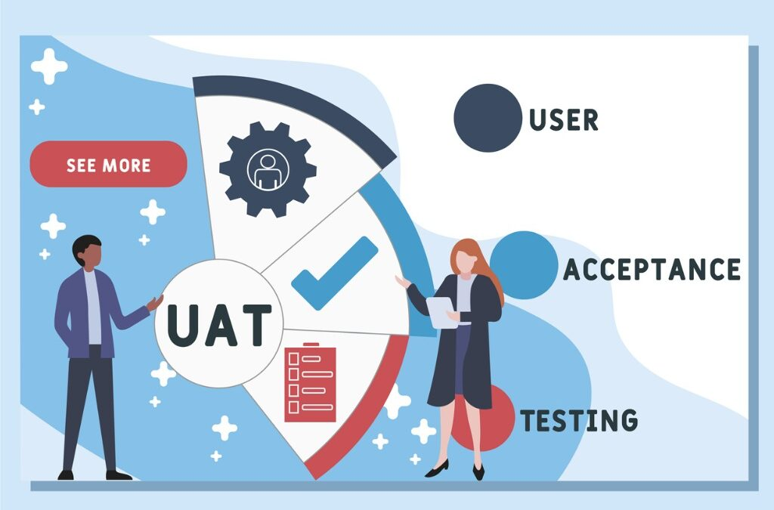
7) User Acceptance Testing
Type of testing performed by the end user or client to verify/accept the software system before moving the software application to the production.
Final testing performed once the functional, system and regression testing are completed.
purpose of this testing is to validate the software against the business requirements.
performed after the System Testing.

Slide 13
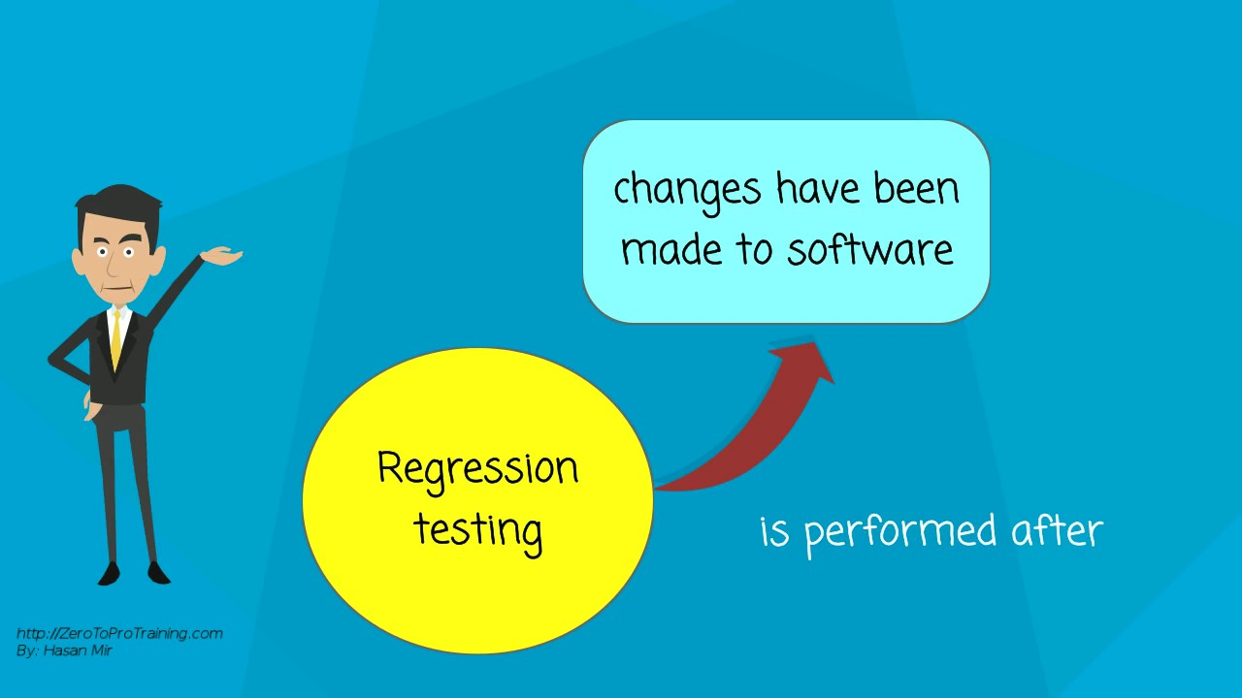
8) Regression Testing
Ensures an application still functions as expected after any code changes, updates, or improvements.
Responsible for the overall stability and
Functionality of the existing features.
Regression testing is the final step, as it verifies
the product behaviours as a whole.
Regression testing is key to improve the
overall quality of the product and user
experience.

Slide 14


